Slide 1
High-Precision Gesture Tracking Privacy-Protected Interface with Rolling Shutter & LED Gloves
Presenters: Soham Naik & Deniz Acikbas
3rd Team-Member: Zaynab Mourtada
Date: 9/18/2024

Slide 2
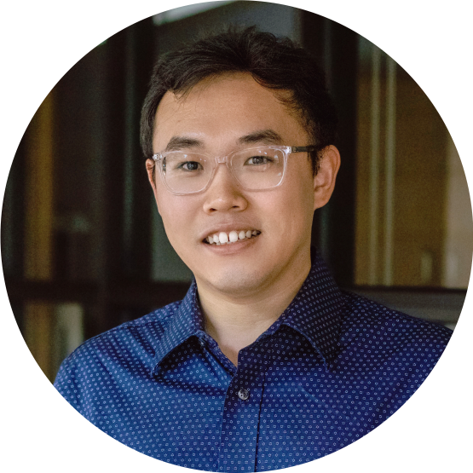
Meet The Client
Client: Dr. Xiao Zhang
Research Interests:
Mobile Computing, AIoT, Cyber Physical Systems, AI-assisted sensing/localization, and HCI
Background:
Postdoctoral Associate at Duke University.
Ph.D. degree in the Computer Science and Engineering at Michigan State University
M.S. degree at Northwestern Polytechnical University
B.E. degree with honor at Taiyuan University of Technology.
Personal Website: https://www.zhangxiao.me/#home

Slide 3
Project Overview
Objective:
Develop a mobile app to stabilize and smooth finger gestures using rolling shutter cameras in a 3D environment.
Approach:
Utilize rolling shutter effect & provided LED gloves for accurate 3D gesture tracking.
Scope:
Address limitations in current gesture tracking technology.
Improve clarity and usability for handwriting and other gestures.
Notes:
Be more specific - software not hardware, mobile app

Slide 4
Deliverables
High-Precision Gesture Tracking:
Develop software for accurate finger gesture tracking.
3D Smoothing Technology:
Implement techniques to smooth and enhance gesture paths.
Mobile App Development:
Create an app for real-time tracking and processing of gestures using smartphone cameras.
Privacy Protection:
Incorporate features to filter out non-relevant information and enhance user privacy.

Slide 5
Why This Project Matters
Relevance
Significant Impact
Skill Development
Publication Potential
Address privacy and accuracy challenges in gesture tracking.
Healthcare
Precision
Diverse Applications
Rolling shutter cameras
LED tracking
Mobile app dev
Machine learning
Image processing.
Enhance your resume and research prospects with potential for official publication.
Notes:
Relevance:
Current Issues: Address privacy and accuracy challenges in gesture tracking.
Significant Impact:
Healthcare: Mitigate tremors and motor symptoms in conditions like Parkinson’s disease.
Precision: Enhance tasks such as writing, drawing, and object manipulation.
Applications: Utilize in healthcare, AR/VR, and smart home IoT.
Skill Development:
Experience: Gain expertise in rolling shutter cameras, LED tracking, mobile app development, machine learning, and image processing.
Publication Potential:
Opportunity: Enhance your resume and research prospects with potential for official publication.

Slide 6
Technical Implementation
Capture:
Use the phone's camera to record rolling shutter footage of hand gestures.
Filter out non-relevant data to protect privacy.
Track:
Follow finger movements across consecutive frames.
Analyze:
Extract gesture data and determine the path.
Rebuild:
Reconstruct finger trajectories in 3D, correcting for distortions.
Smooth:
Apply techniques to refine and clarify gesture paths.
Future-Proofing:
Store data in a versatile 3D format for future integration.

Slide 7
DEVELOPMENT TIMELINE
Project Planning
Research & Framework
Prototyping
Testing
Define scope, objectives, and create a project plan
Study rolling shutter constraints, LED gloves integration, and relevant technologies.
Develop UI/UX
Integrate Feed
Create 3D Simulation
Implement Tracking
Test app features, hardware integration, and gesture accuracy.
Refinement
Final Product
Deployment
Refine algorithms, UI/UX based on feedback.
Finalize app, prepare documentation.
Launch the application and ensure future compatibility.

Slide 8
Challenges We See
Distortion Management:
Depth & Frame Analysis: Handling rolling shutter distortions in 3D gesture tracking.
3D Simulation: Accurate reconstruction of gestures from distorted frames.
Smoothing: Applying ML and image processing to refine gestures.
Real-Time Processing:
Gesture Tracking: Ensuring precise and rapid gesture processing.
ML Adaptation: Training models to recognize and adapt to individual gesture styles.
Performance: Balancing system performance with complex algorithms.
Integration:
Seamlessly combining developed software components with provided hardware.
Privacy:
Balancing accurate tracking with stringent privacy protection.

Slide 9
Seeking Individuals Passionate About
Project Management
3D Simulation
Algorithm Development
Android App Development
GitHub Trello Discord
Unity3D or Unreal Three.js OpenGL or Vulkan
Machine Learning: TensorFlow or PyTorch
Image Processing: OpenCV or SkiKit
Android Studio Kotlin or Java ARCore Firebase

